Slide 1


Olist Store Analysis
Presented By Group 2

Slide 2






Ms. Falguni Vaghasia
Mr. Badal Babu Chavan
Ms. Shivani Pachkede
Mr. Kharvel Mohan Khobarekar
Ms. D. C. Shaheena
Ms. Kaipa Tejaswini

Slide 3
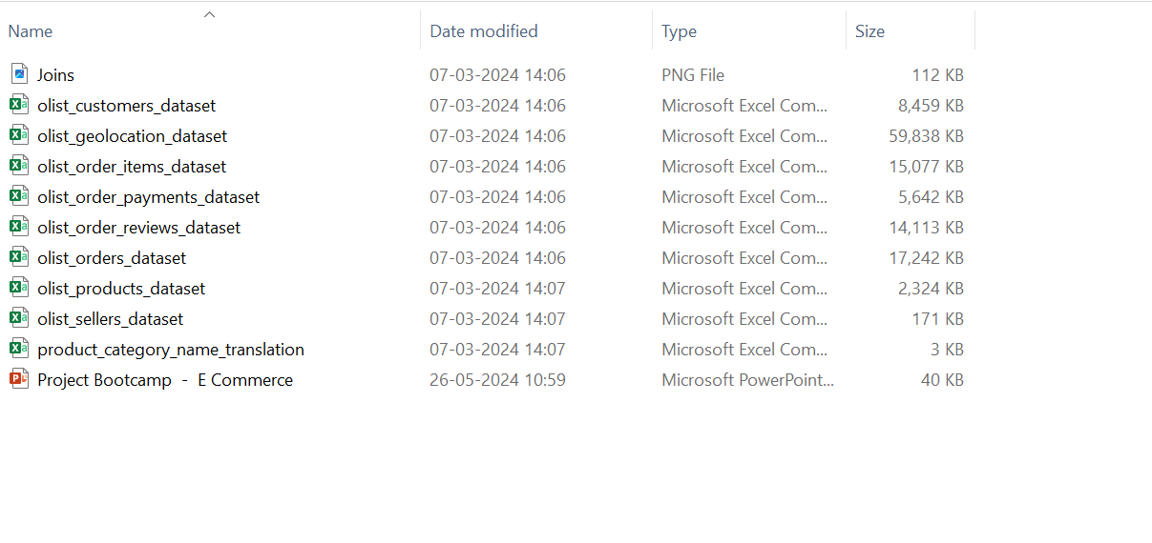
Data Set
.
The Olist Store Analysis project focuses on understanding customer buying behaviors and payment statistics on the Olist e-commerce platform.
It analyzes key performance indicators(KPI’s) like weekday vs weekend sales, payment statistics, delivery times, and customer behavior.
The analysis is based on nine CSV files, which are cleaned and manipulated to extract valuable insights.

Slide 4
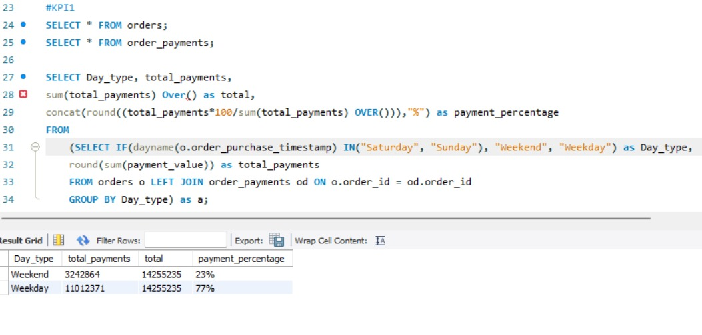
KPI-1
Weekday vs weekend payment statistics
.
Weekday Vs Weekend (order_purchase_timestamp) Payment Statistics
Helps to understand the customer buying behaviour.
Reveals which days have the highest sales.
Allows Olist to enhance weekdend sales and plan targeted promotions.

Slide 5
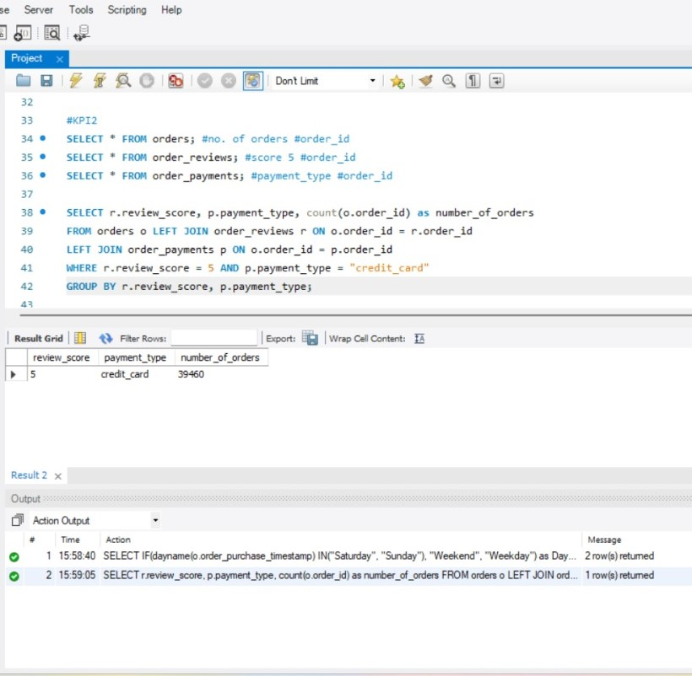
KPI-2
Payment type with review score 5
Number of Orders with Review score as 5 And payment type as Credit card
Helps to understand customer satisfaction and payment preferences
Allows the store to target satisfied customers for repeat purchases.

Slide 6
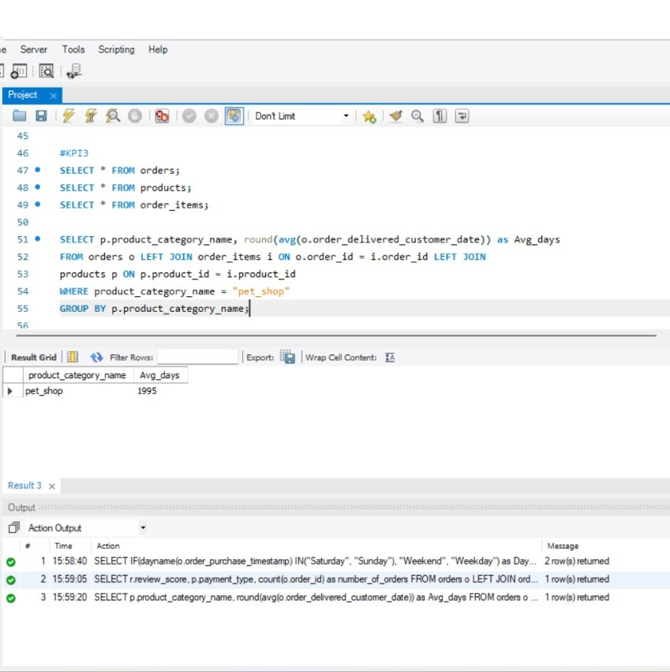
KPI-3
Average number of delivery days taken for pet shop
Average number of days taken for order_delivered_customer_date for pet_shop
This KPI measures the average delivery time for pet shop orders.
It helps Olist identify opportunities to improve delivery speed and maintain customer satisfaction.

Slide 7
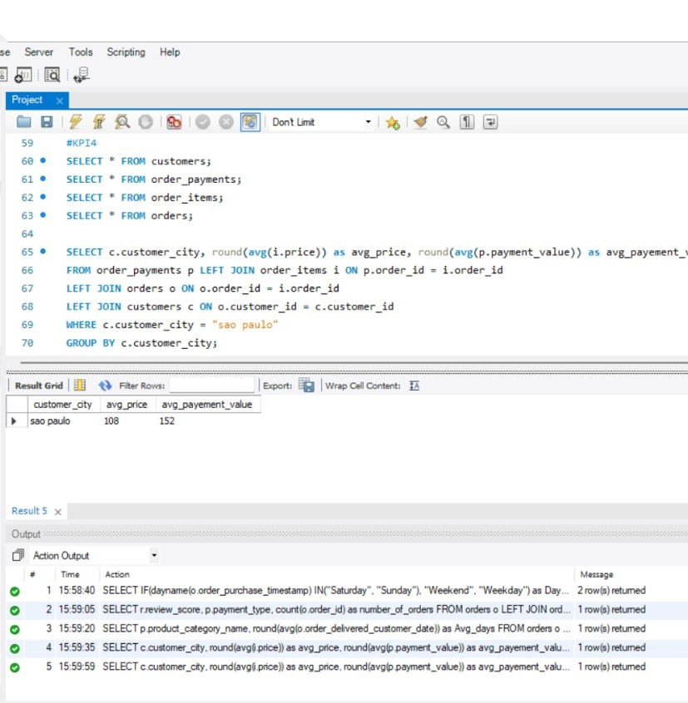
KPI-4
Average price and payment value of Sao Paulo city.
Average price and payment values from customers of sao paulo city
Reveals their spending habits and purchasing power of customers.
Helps the Olist to identify segments of high-value customers within this demographic.
Olist can tailor marketing campaigns to effectively target these customers,to increase sales and customer loyalty.

Slide 8
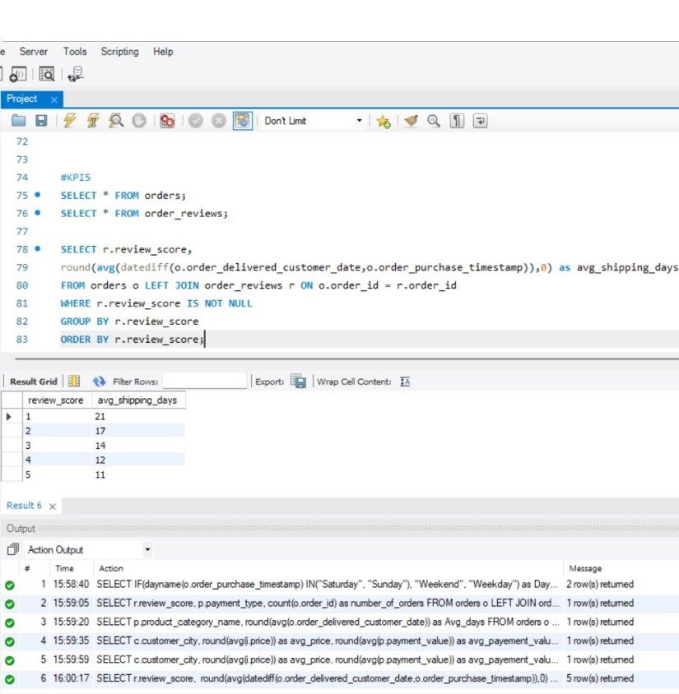
KPI-5
Average shipping days vs review scores.
Relationship between shipping days (order_delivered_customer_date_order_purchase_timestamp) Vs review scores.
This KPI measures how shipping days, time taken between order placement and delivery, correlate with review scores.
This helps how delivery speed influences customer satisfaction levels.

Slide 9
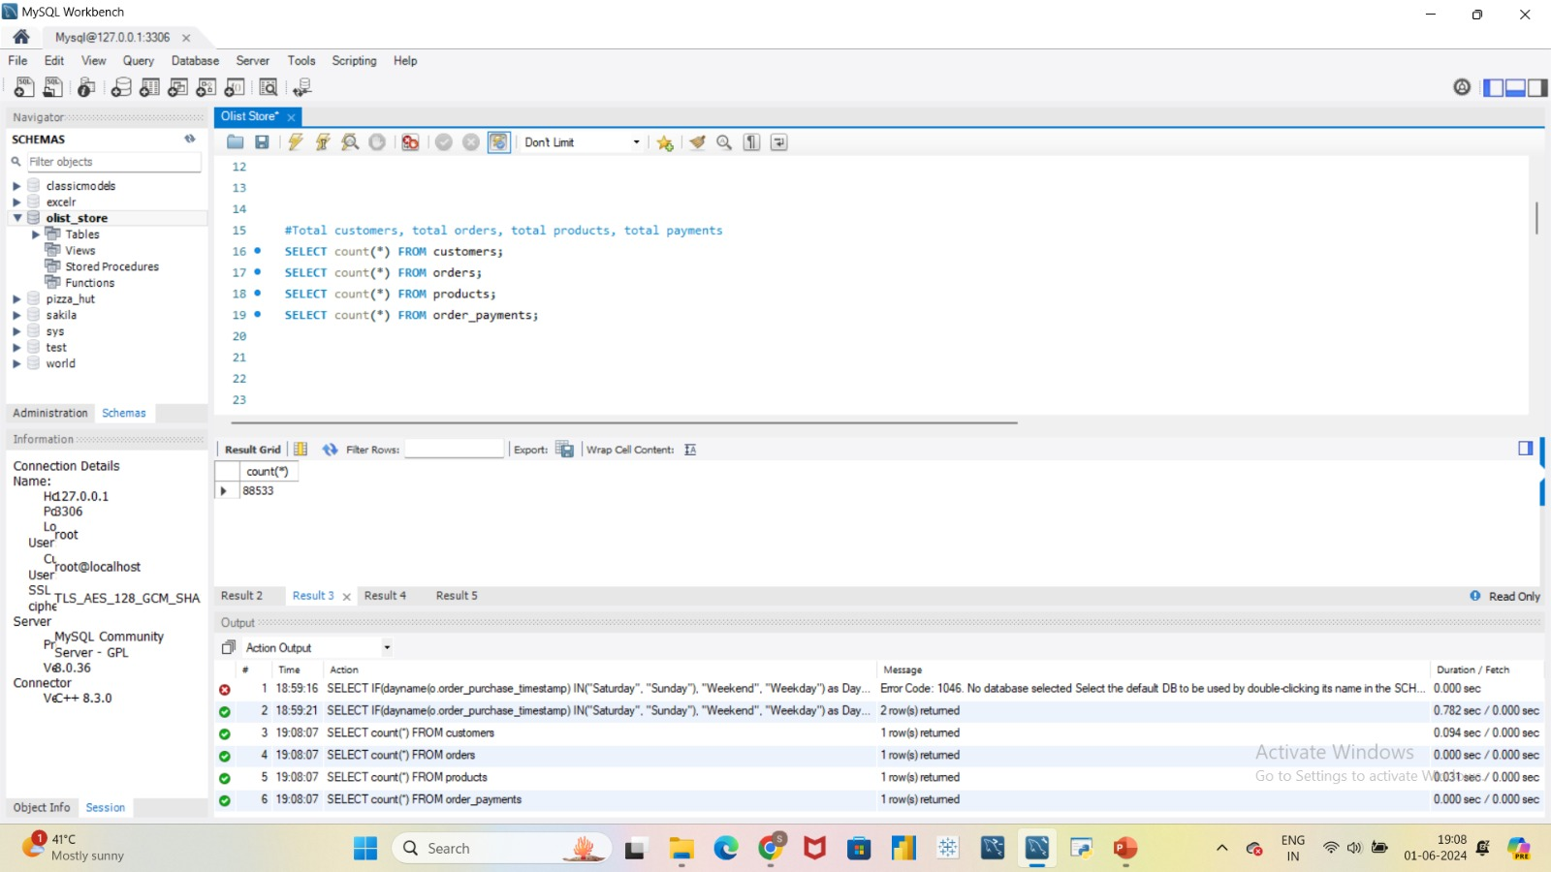


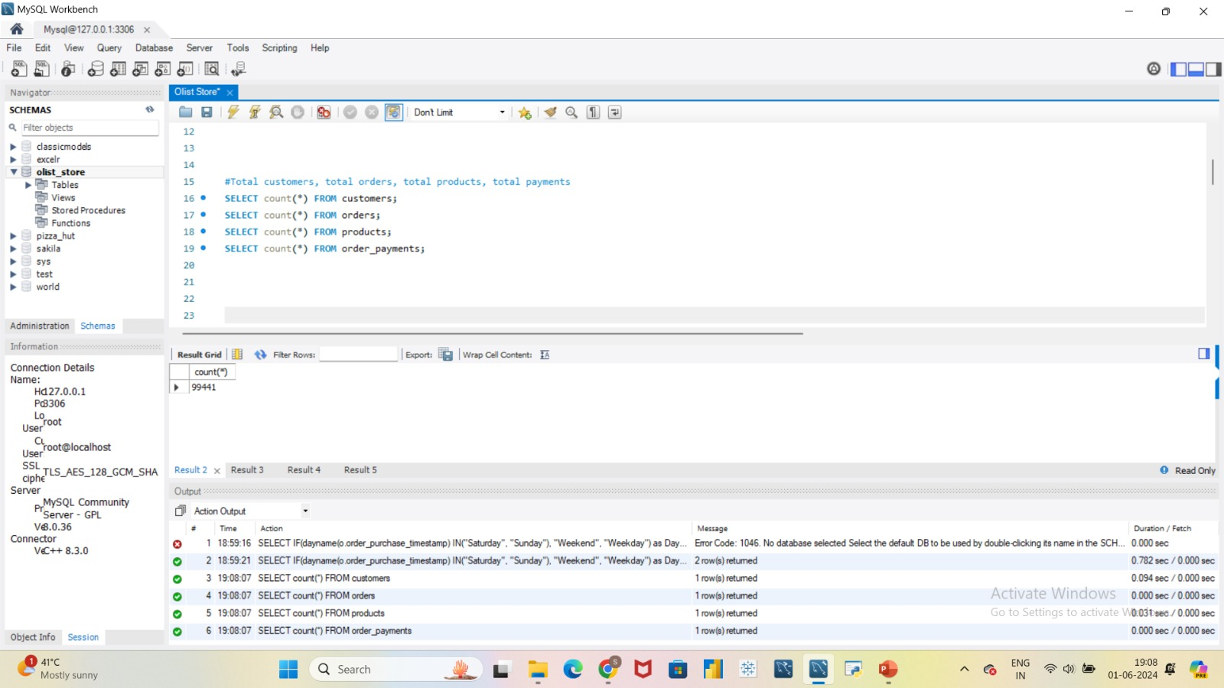
Additional Insights
Total Orders
Total Products
Total Payments
Total Customers

Slide 10
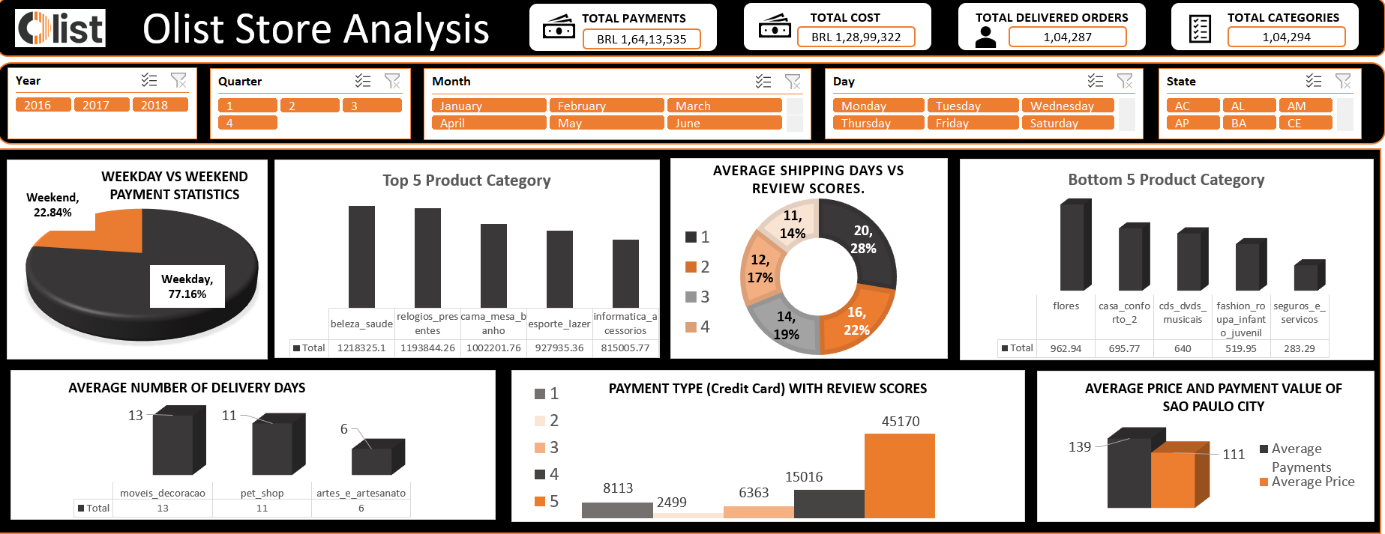
Excel Dashboard

Slide 11
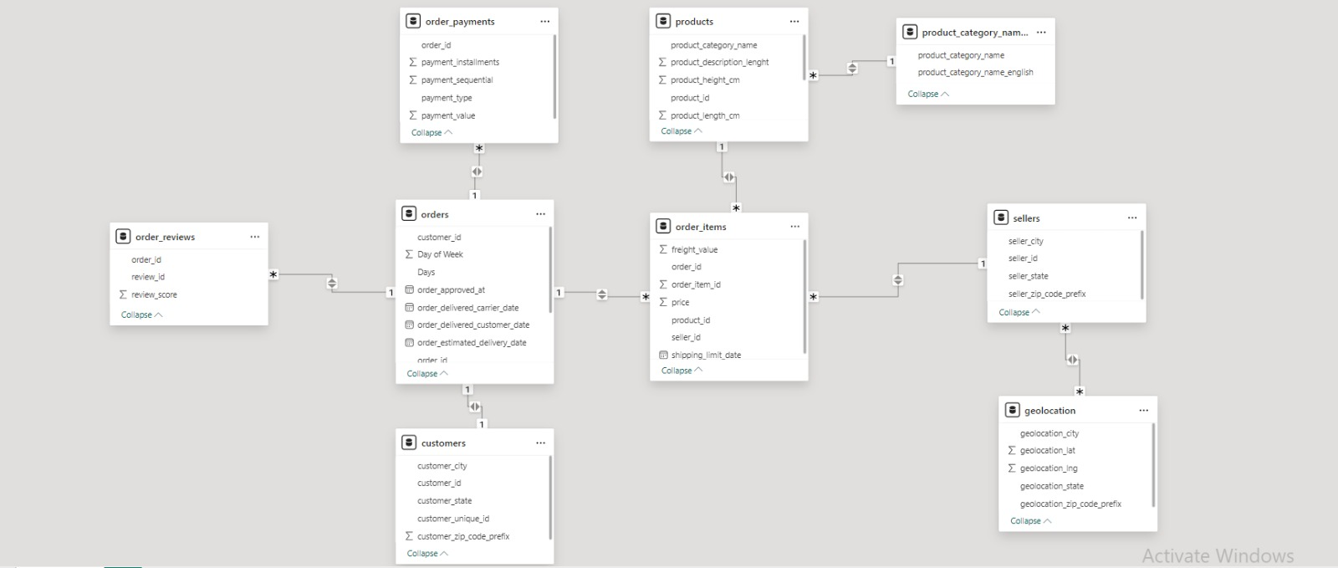
Power BI Data Modelling

Slide 12
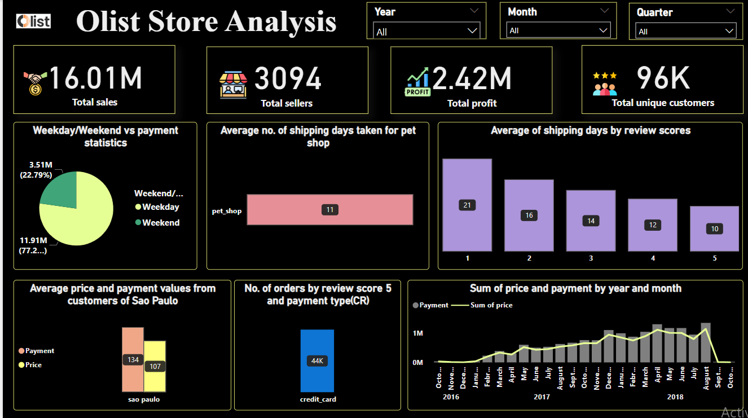
Power BI Dashboard

Slide 13
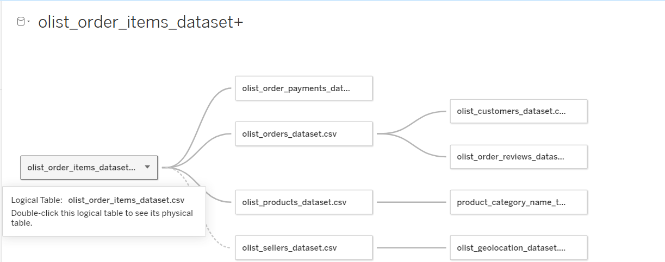
Tableau Dashboard

Slide 14
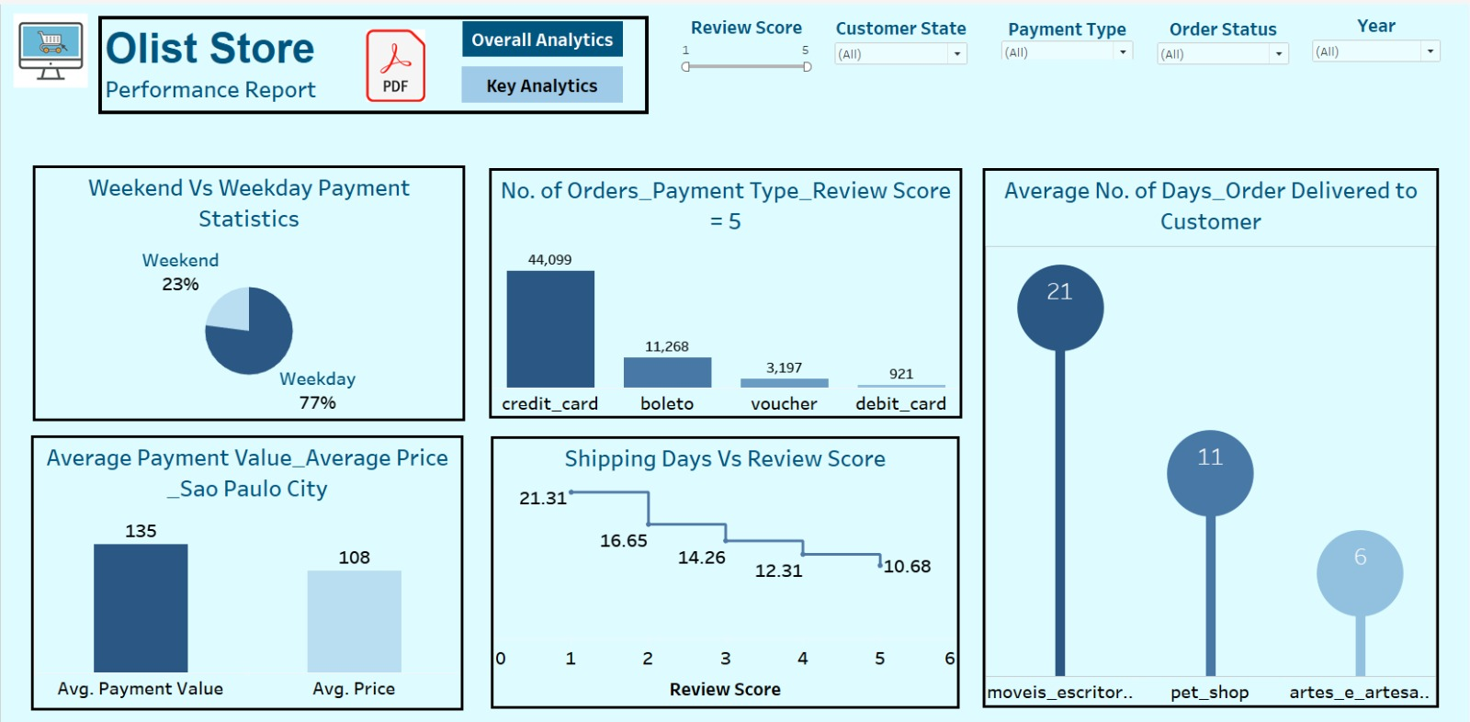
Tableau Dashboard

Slide 15
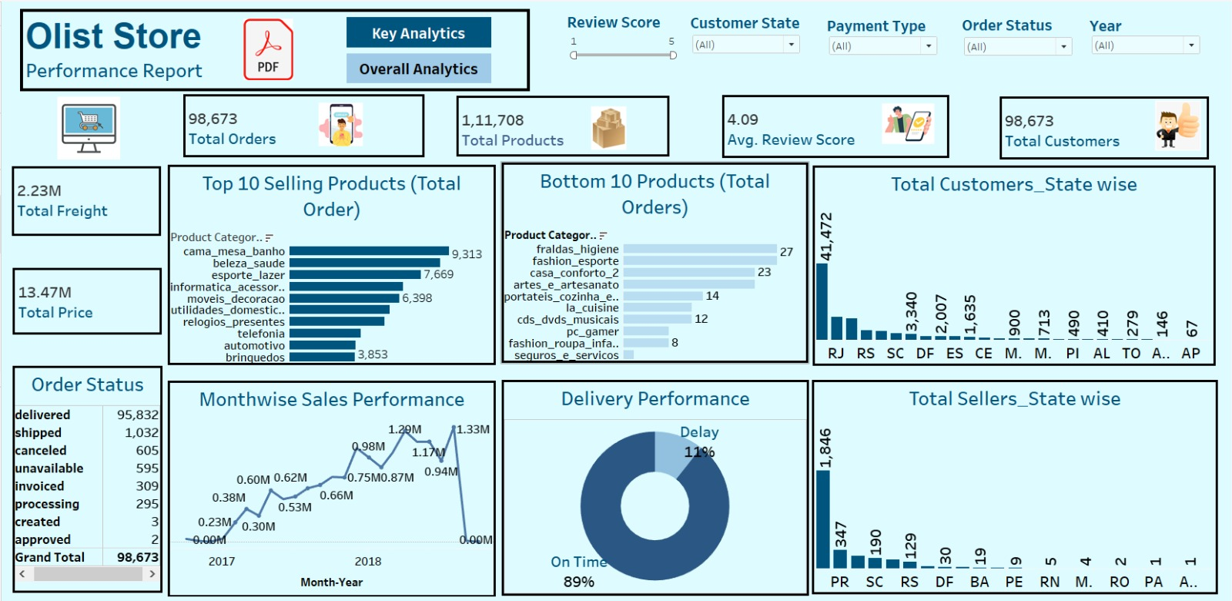
Tableau Dashboard

Slide 16
Insights
According to the data, Olist E-commerce has about 99,440 orders. With about 89,940 orders being delivered, the company has a 90% delivery success rate.
Their average product rating is 4.09 stars, with product categories going as high as 4.67 stars and as low as 2.5 stars.
I Star reviews are on third place in the review score distribution ranking which likely indicates that there could be problems with product quality in some product categories.

Slide 17
Summary
Overall, regular monitoring of customer reviews, real-time tracking of fleet performance, and proper shipment tracking and communication system can improve Olist's delivery and supply chain performance and ensure customers are delighted with the service.

Slide 18
Conclusion
The Olist Store Analysis project provides valuable insights into customer behavior and payment statistics. The analysis of these KPIs helps Olist in identifying areas of improvement and creating targeted marketing campaigns.
As a data analyst, We have used Excel and Power BI to clean and manipulate the dataset
We have Used Power Bi & Tableau to create meaningful visualizations.
We have used SQL for data validation

Slide 19


